Slide 1
Investigation on data-related jobs across United States
Jiaxu Luo
2016/07/18

Slide 2
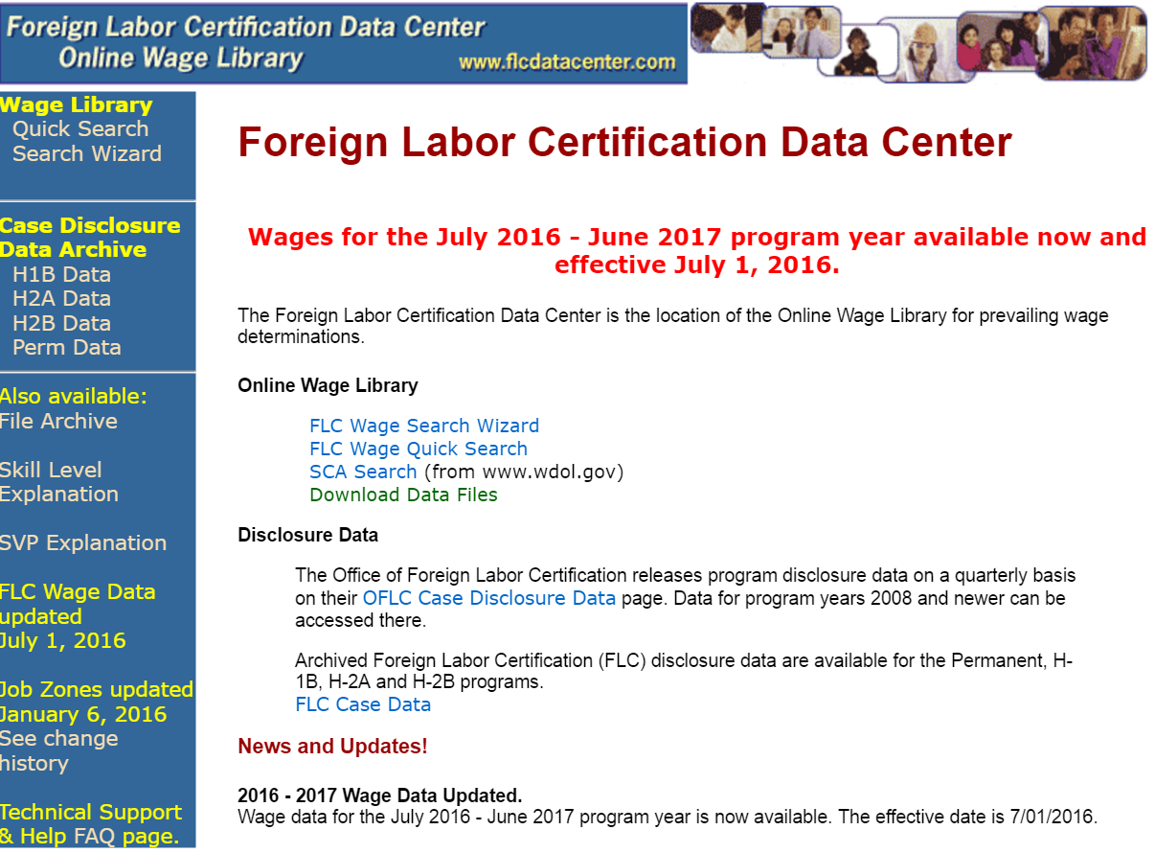
Dataset

Slide 3
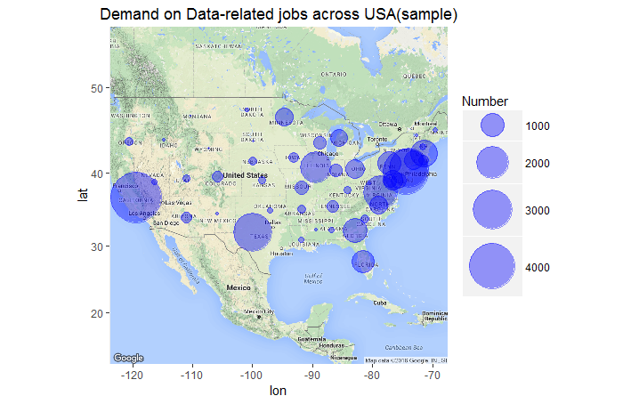
what is the data-related jobs demand distribution across United States?

Slide 4
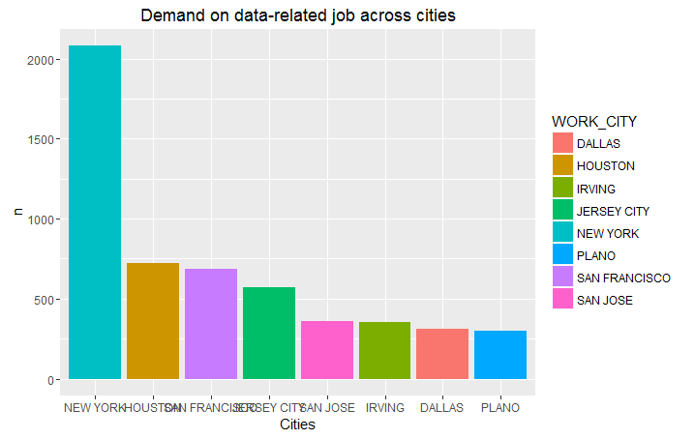
which city in CA,NY,NJ,TX have more demand on data-related jobs?

Slide 5
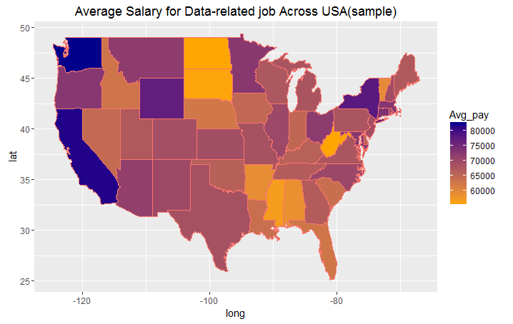
which states provides higher average salary for data-related jobs?

Slide 6
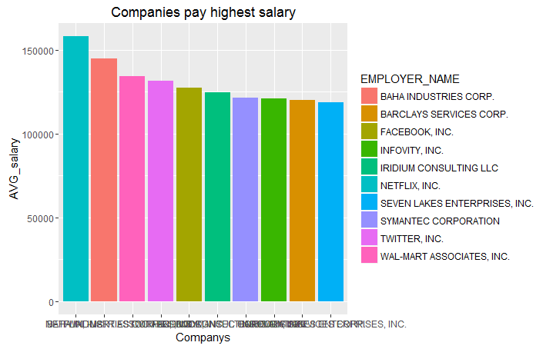
Which companys in CA,NY or WA provide more salary than others?

Slide 7


